Slide 1

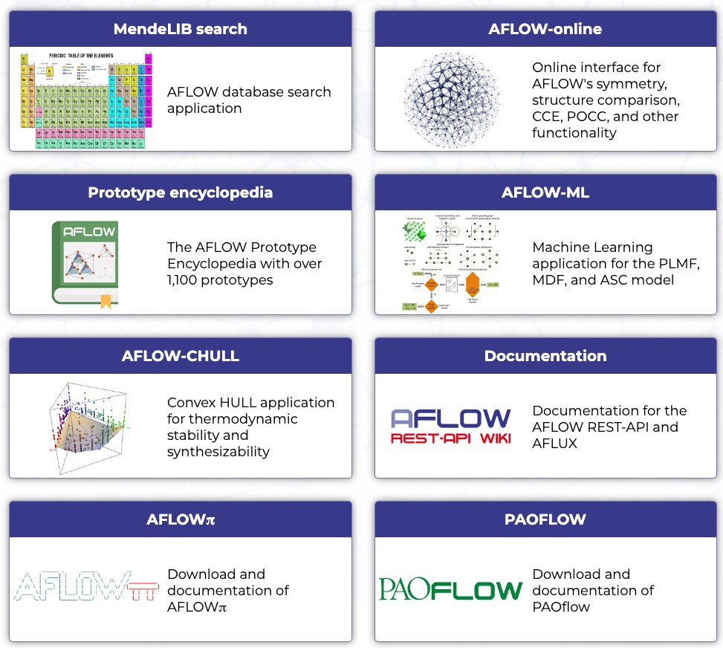






AFLOW School for Materials Discovery
Advanced Research Computing at Hopkins

Slide 2
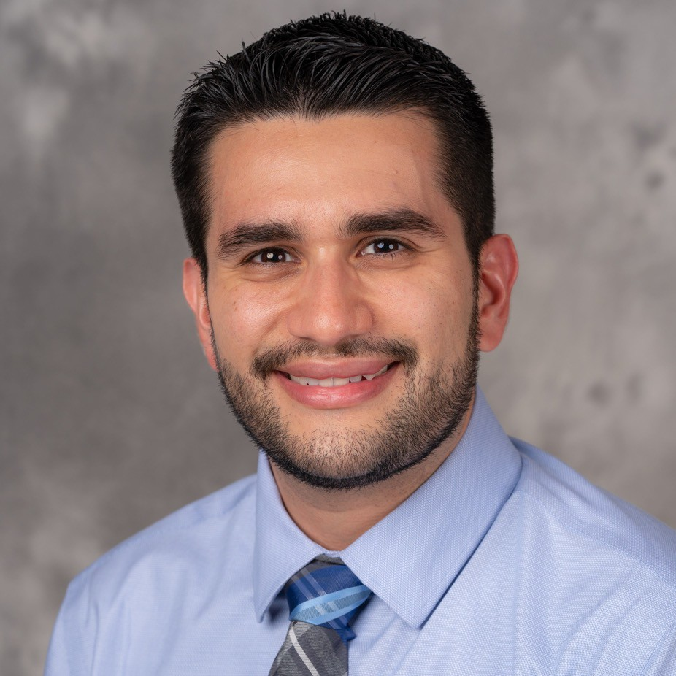
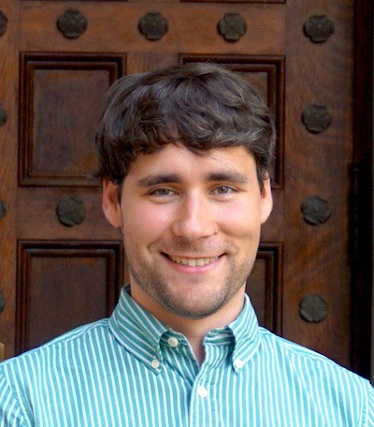
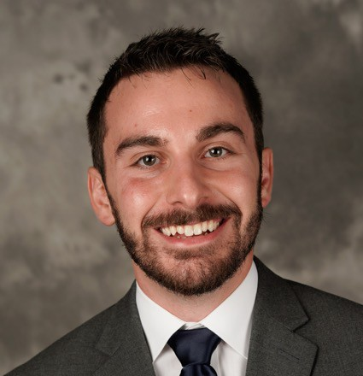
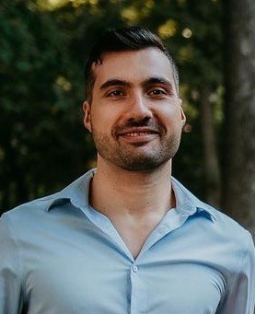
AFLOW Speakers and Consortium
AFLOW Consortium
S. Curtarolo, C. Toher, X. Campilongo, M. Esters,
R. Friedrich, A. Smolyanyuk, S. Ki, E. Gossett, M. Mehl,
O. Levy, F. Rose (Duke), D. Brenner (NCSU),
M. Fornari (Central Mich.), M. Buongiorno Nardelli (UNT),
E. Zurek (U-Buffalo), R. Hanson (St. Olaf),
G. Henkelman and W. Chai (UT-Austin),
M. D. Hossain and J.-P. Maria (Penn State),
K. Yang, T. Harrington, and K. Vecchio (UCSD),
O. Isayev (CMU), A. Tropsha (UNC),
V. Stanev and I. Takeuchi (U-Maryland),
A. Calzolari (CNR-NANO),
S. Sanvito (Trinity Dublin), Y. Lederer (NRCN),
A. Hever and A. Natan (Tel Aviv U.),
S. Gold and L. Kronik (Weizmann Institute),
J. Carrete and N. Mingo (CEA-Grenoble)
Corey Oses
Hagen Eckert
David Hicks
Simon Divilov

Slide 3
Schedule and Syllabus
Time (EST) | Session
8:30am | Coffee and pastries
9:00am | Introduction
9:30am | Session 1: Machine learning
10:00am | Session 2: Crystallographic tools
11:00am | Coffee break
11:15am | Session 3: aflow.org database and APIs
11:45am | Session 4: Thermodynamic stability
12:15pm | Conclusion
Session 1: Machine learning (C. Oses)
Models: PLMF (electronic + vibrational), MFD (vibrational), and ASC (superconductivity)
Session 3: aflow.org database and APIs (H. Eckert)
Database organization
aflow.org web portal
AFLUX search-API
AFLOW-ML web interface
AFLOW-ML API
Session 4: Thermodynamic stability (S. Divilov)
Convex hull analysis
AFLOW-CHULL online tool
Session 2: Crystallographic tools (D. Hicks)
AFLOW-SYM
AFLOW prototype encyclopedia
AFLOW-XtalFinder
AFLOW Support break-out room: Technical support for issues with Zoom, binder, exercises, etc.
Quick questions or issues? Send private message to anyone with “(AFLOW Organizer)” in their name.

Slide 4
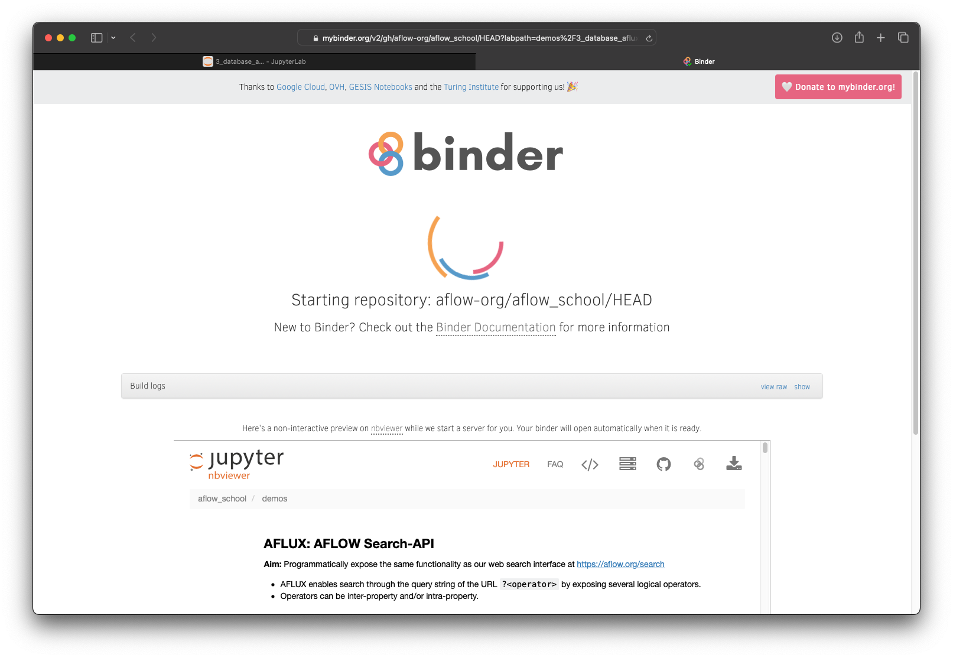


Binder Notebooks
mybinder.org
Allows you to start the exercises directly in a pre-configured environment in your browser
When a demo or exercise is started, we show the direct links to the documents
You can also start the environment now and switch between the documents
The source code can be found at Github
start on mybinder.org
https://mybinder.org/v2/gh/ aflow-org/aflow_school/HEAD
open on github.com
https://github.com/aflow-org/aflow_school
4

Slide 5
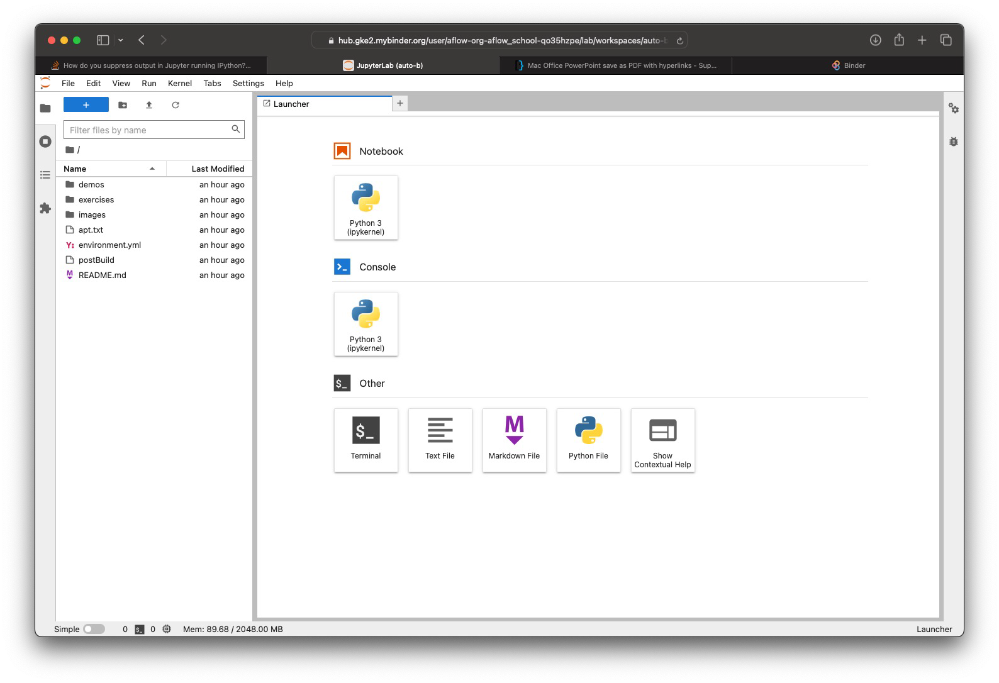
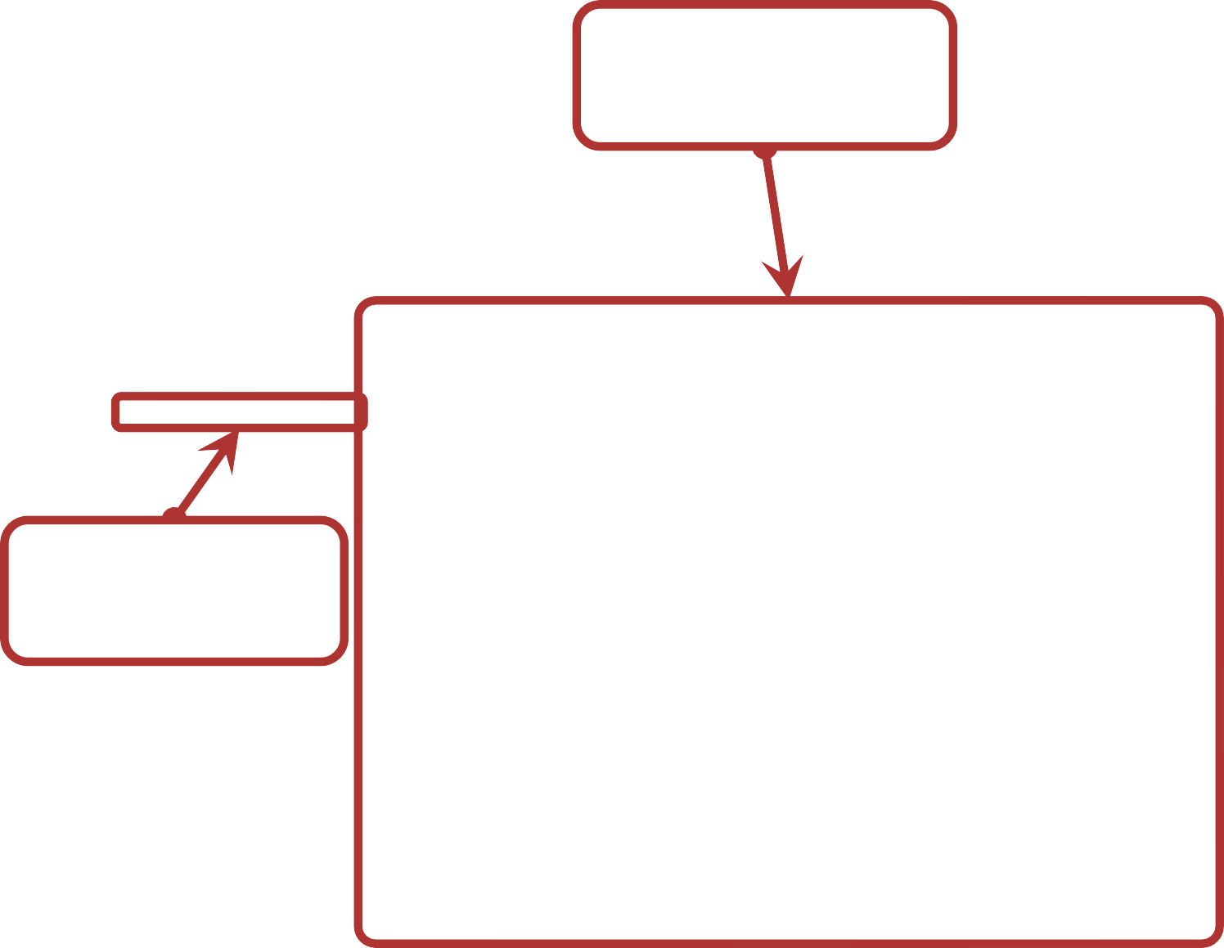
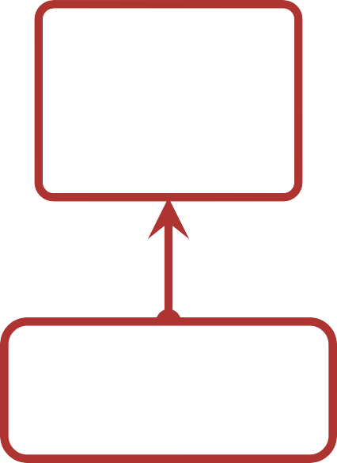
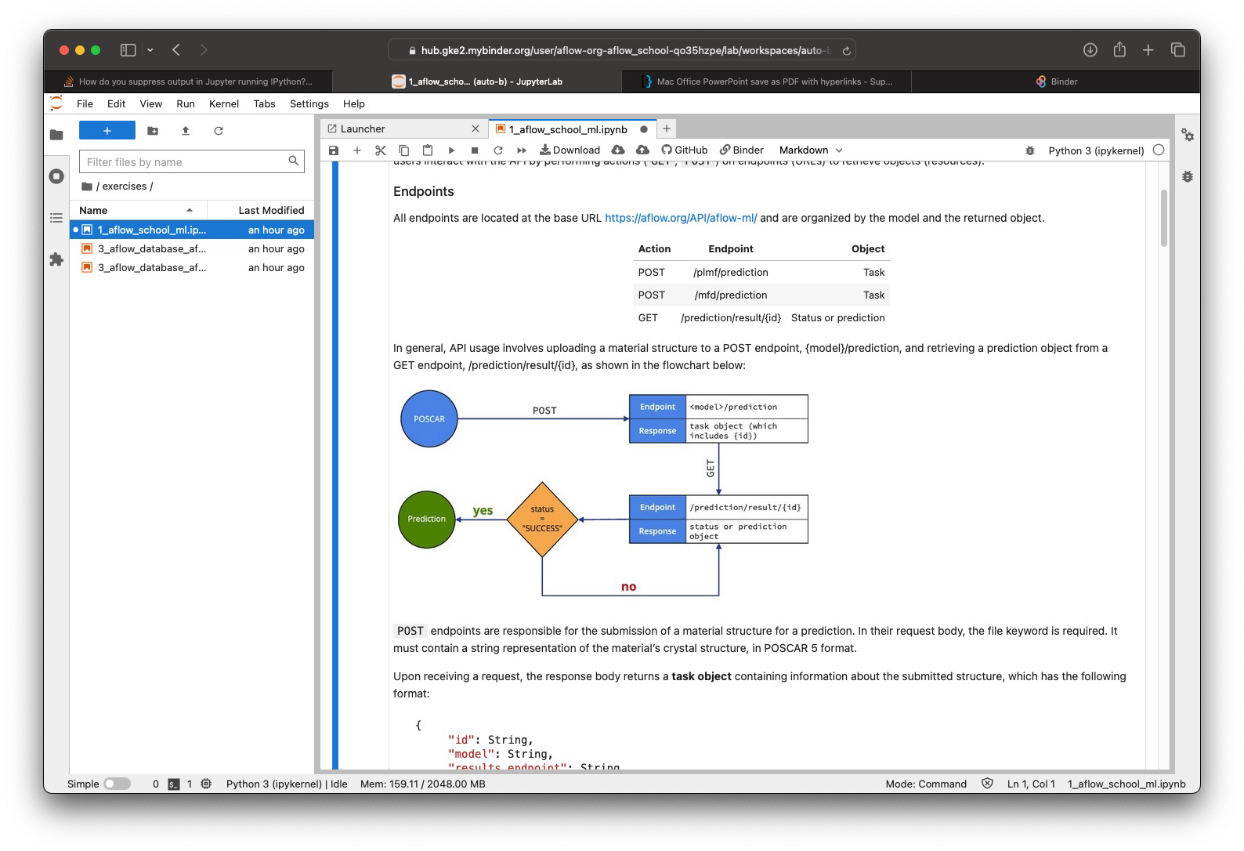
Binder Notebooks
Open notebook
Navigation bar
Exercises file (double click)

Slide 6


AFLOW-ML API
Exercises
AFLOW-ML API
start on mybinder.org
https://mybinder.org/v2/gh/aflow- org/aflow_school/HEAD?labpath=exercises
%2F1_aflow_school_ml.ipynb
open on github.com
https://github.com/aflow- org/aflow_school/blob/main/exercises/ 1_aflow_school_ml.ipynb

Slide 7
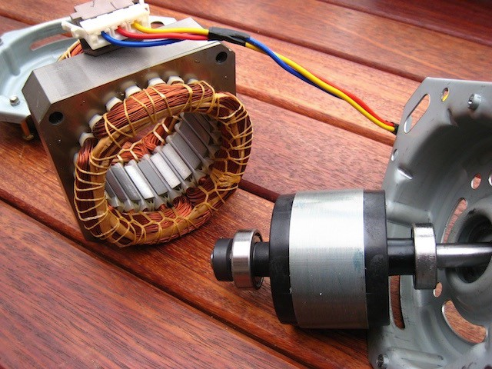
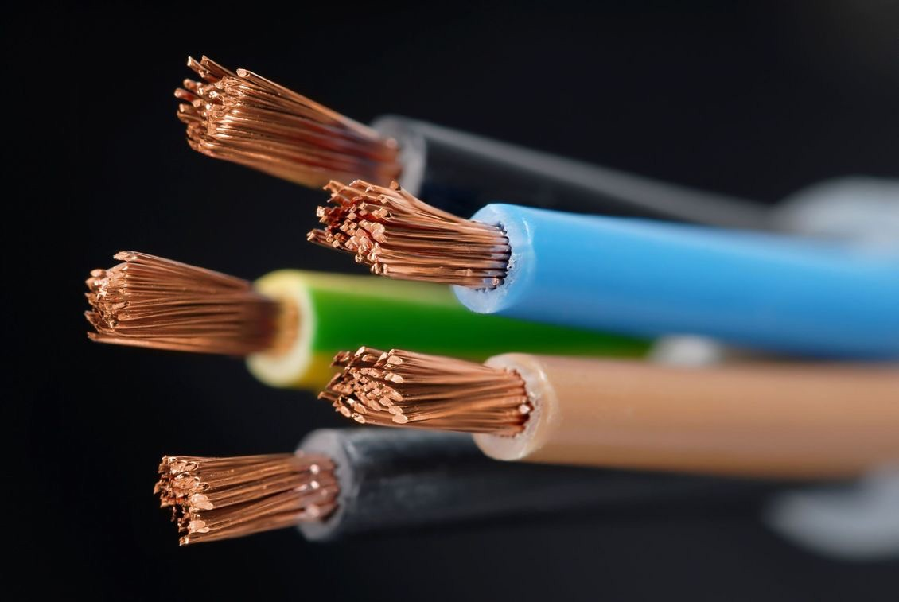
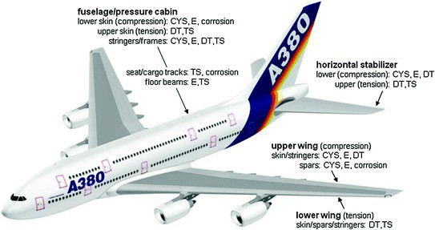
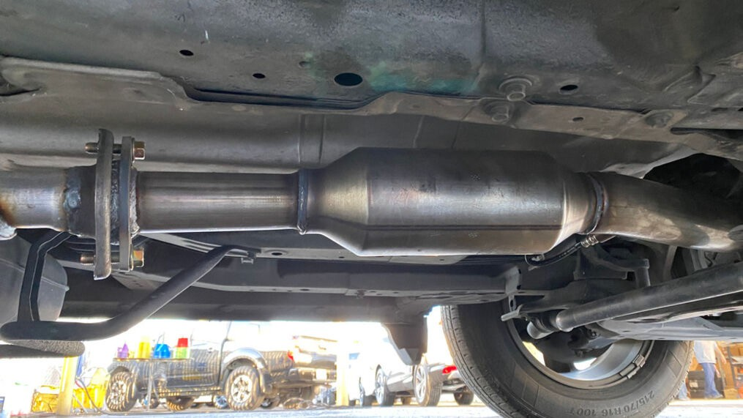
Materials Development
applications
electric motors
traditional/historical (Deus ex machina): passive
properties
materials
magnetic
conducts electricity strong/lightweight ductile
good catalytic activity wear-resistant
chemical attack-resistance high-temperature functionality
electronics/circuits
iron copper bronze steel aluminum brasses platinum
characterization
engineering
aerospace
catalytic converters
materials discovery: active

Slide 8
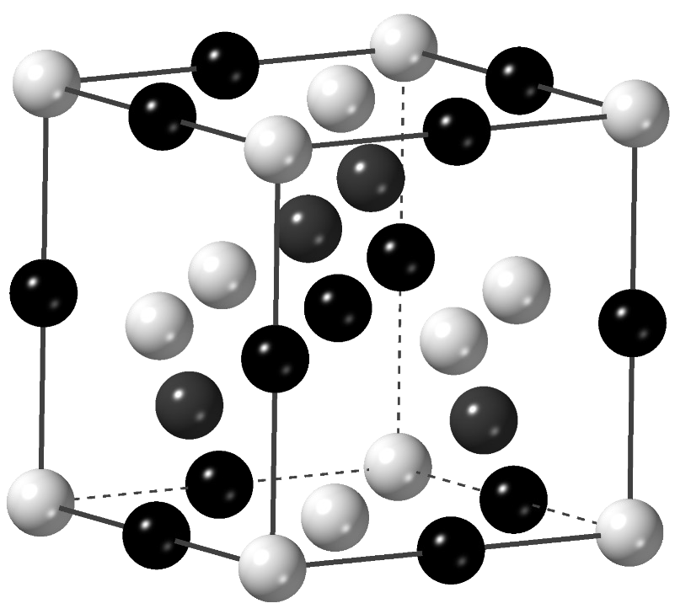
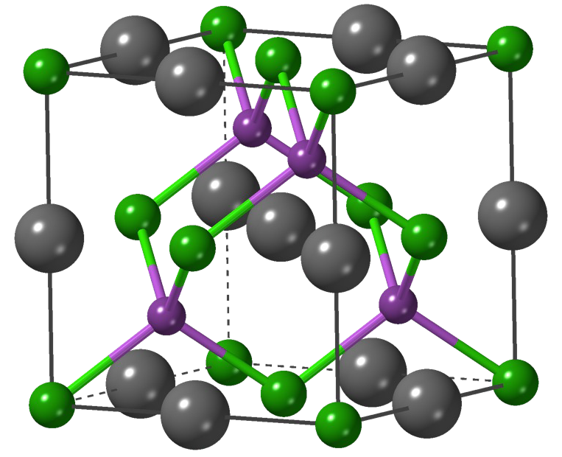
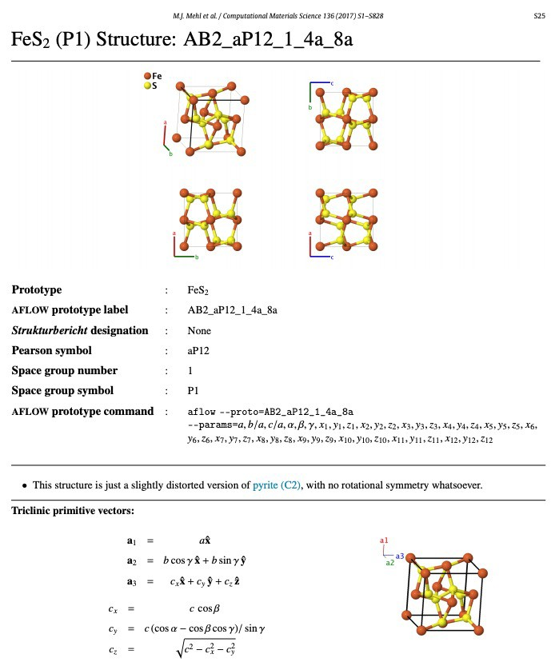
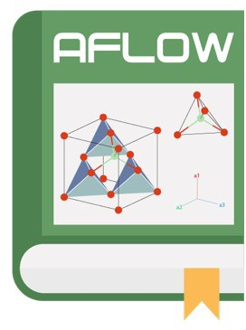
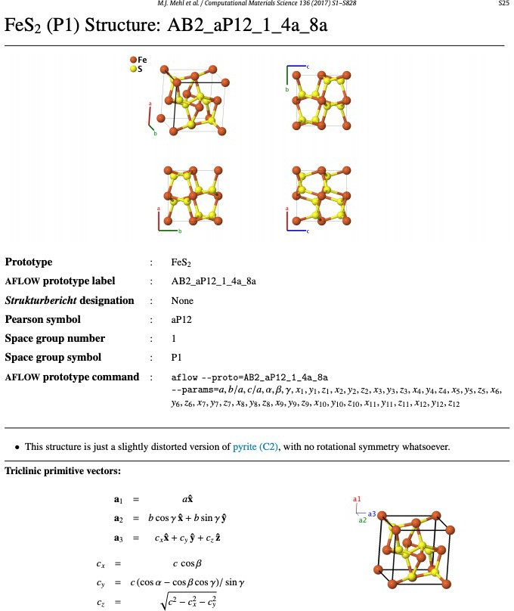
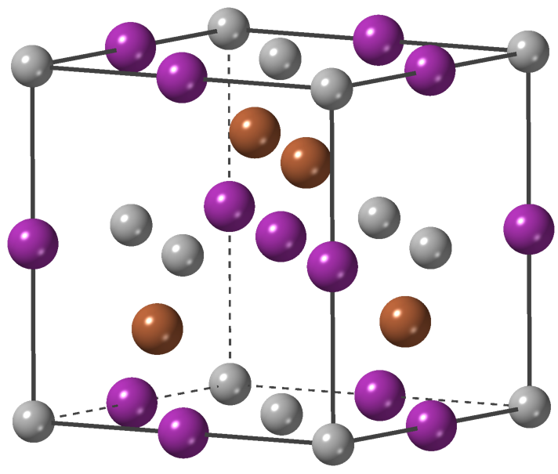
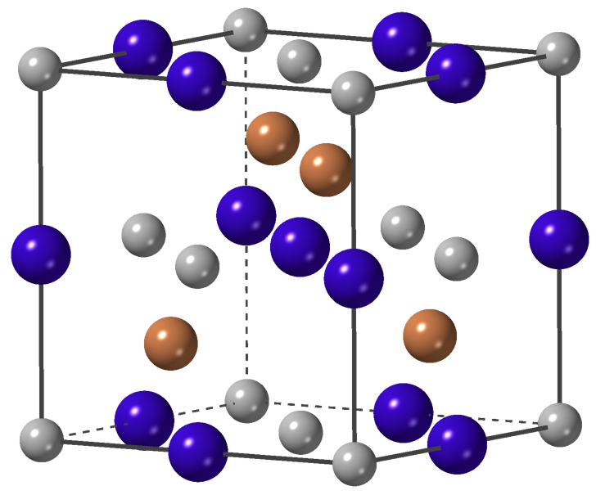
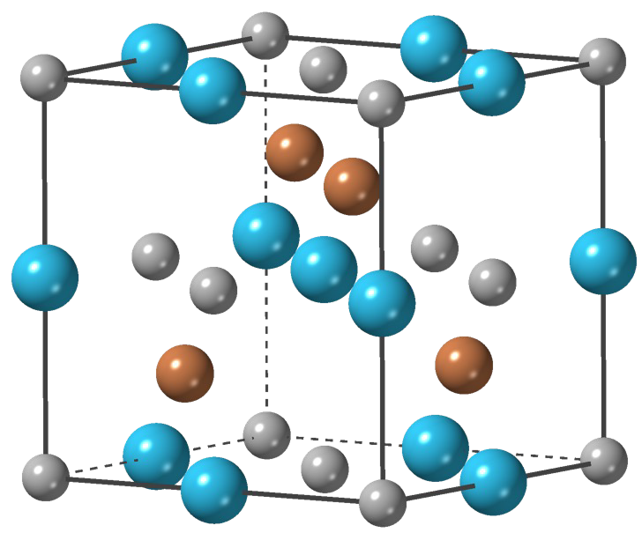
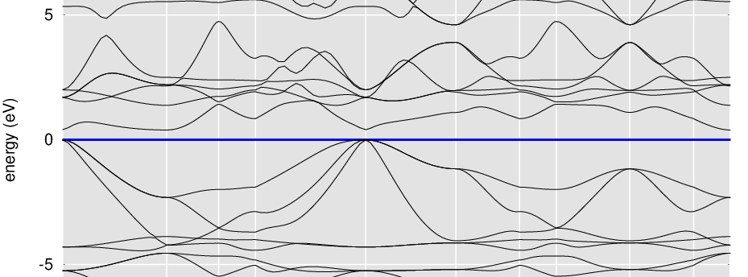
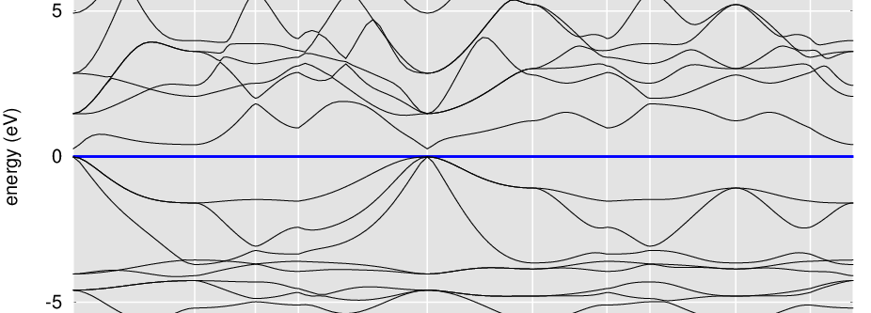
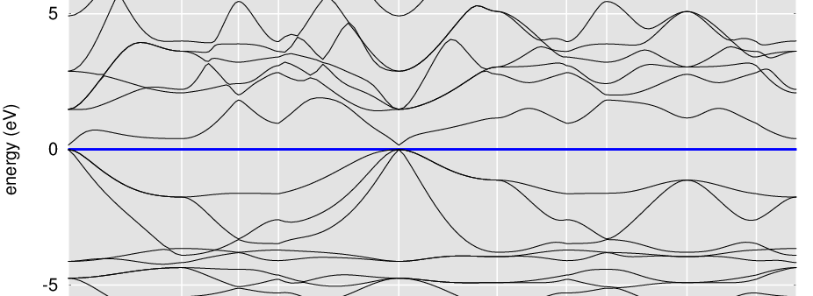
Inspiration from nature
Half-Heusler
The AFLOW Prototype Encyclopedia
extract backbone
AgAsMg
Nowotny and Sibert,
Z. Metallkd. 33, 391 (1941)
ABC
HoPtSb
ScPtSb
TbPtSb
part 1
288 prototypes
Mehl et al., Comput. Mater. Sci. 136, S1 (2017)
part 2
302 prototypes
Hicks et al., Comput. Mater. Sci. 161, S1 (2019)
1,100
prototypes
part 3
510 prototypes
Hicks et al., Comput. Mater. Sci. 199, 110450 (2021)
E = 0.397 eV
E = 0.276 eV
E = 0.161 eV
g
g
g
8

Slide 9
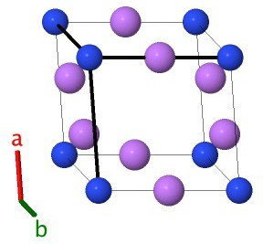
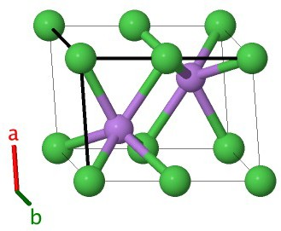
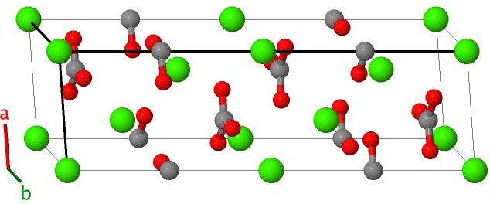
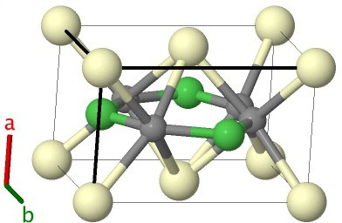
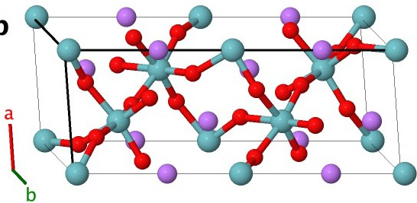
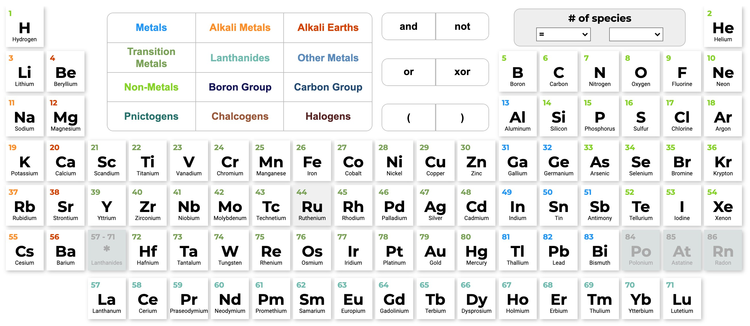
Materials Search Space
AB
AB
ABC
ABC
ABC
_{>10}177
Entropy 16, 4749 (2014)
9

Slide 10
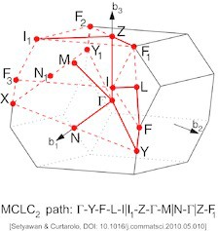
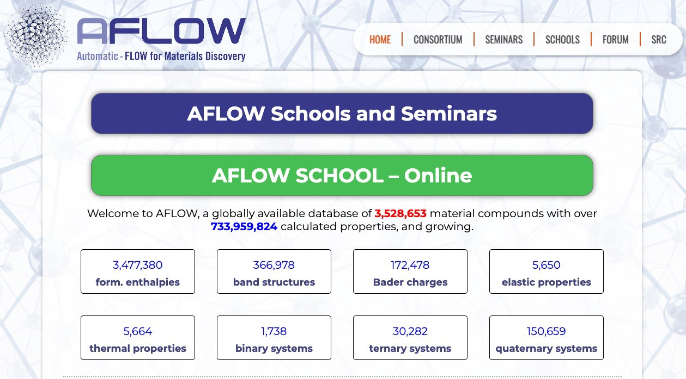





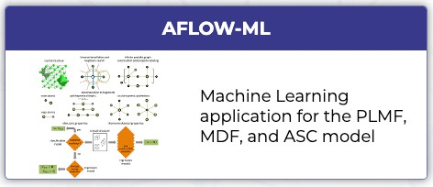
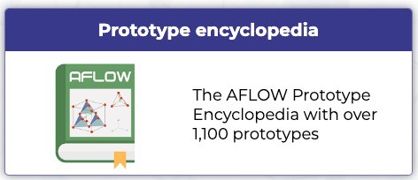
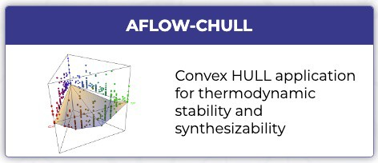
AFLOW: aflow++ and aflow.org
aflow C++ software framework aflow.org repositories
beginnings
AFLOW
DFT-
code
BZ-standard
autonomous materials framework
3.5+ million materials
730+ million properties
Input file generation
aflow.in
DFT-
DFT-
DFT-
Calculation management
code
code
code
ERROR?
Property calculation
Electronic
Thermal
Elastic
Database storage
Storage
machine learning
structure generation
stability + formability
10

Slide 11
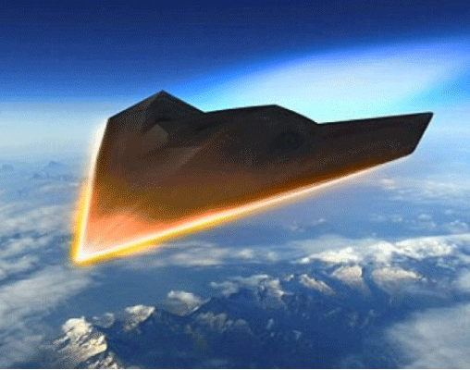
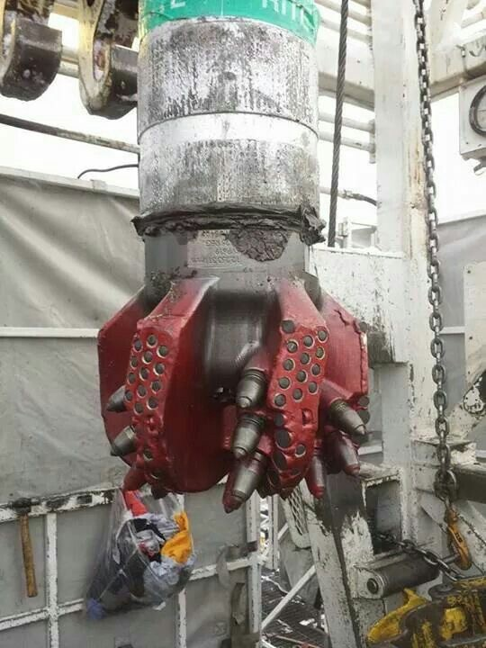



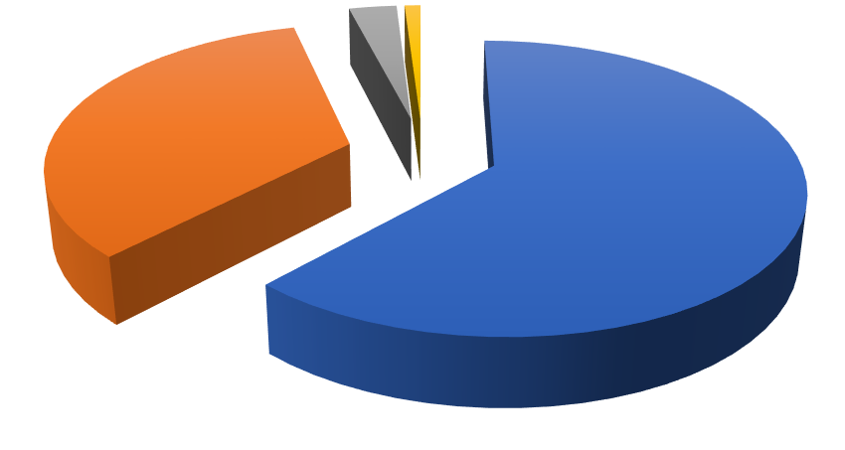






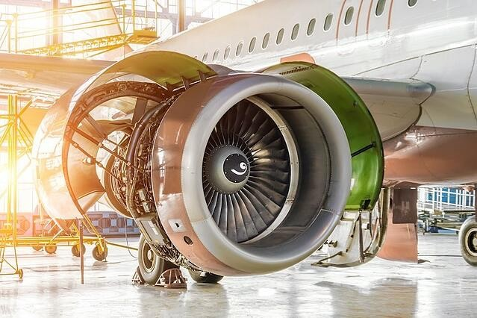
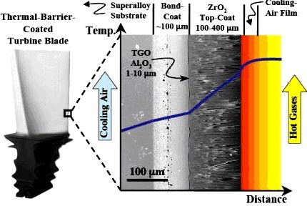
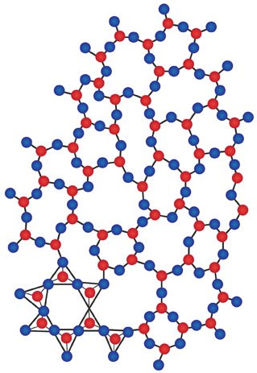
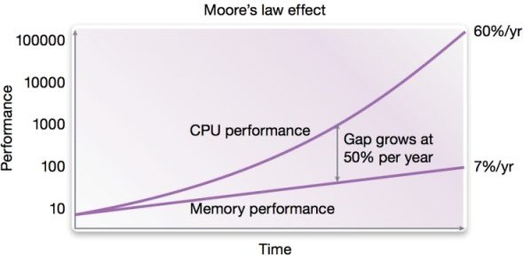
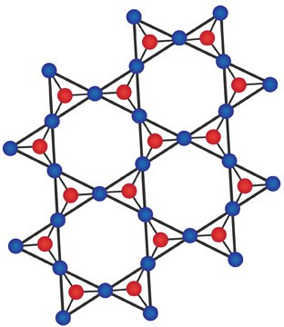
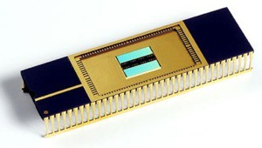
Materials Design with AFLOW
2 rare-earth-free magnets _{3% 1% 2010 100%} NdFeB output
34% |  |  |  | 80% 60%
 |  |  |  | 40%
 |  |  |  | 62%
 |  |  |  | 20%
 |  |  |  | 0%
 |  |  |  | 2003 2004 2005 2006 |  | 2007 |  | 2008
 | NdFeB | ferrite | SmCo | _{Alnico} China Japan Europe Adv. Mater. 23(7), 821 (2011) |  | USA
 |  |  |  | Sci. Adv. 3, e1602241 (2017)
10 high-entropy high-hardness carbides
Nat. Commun. 9, 4980 (2018); npj Comput. Mater. 6, 42 (2020)
2 Co-based superalloys
Acta Mater. 122, 438 (2017); Acta Mater. 151, 137 (2018)
phase-changing memory composition
crystal glass
heat
Nat. Commun. 11, 5966 (2020)
11

Slide 12
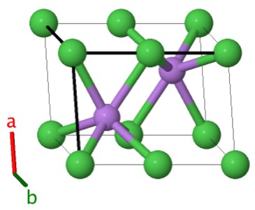
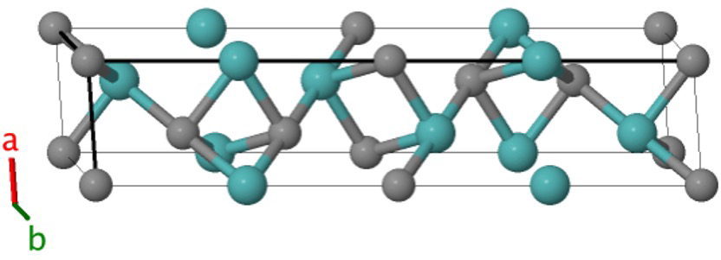
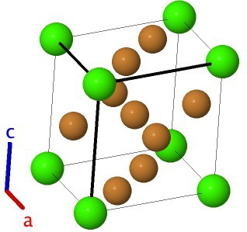
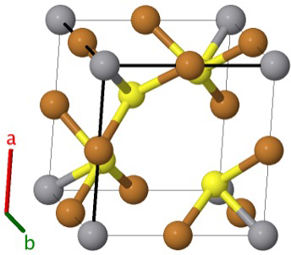
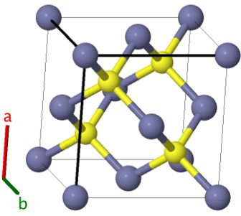
















Materials Discovery Challenge: Materials Space
_{>10}177
Mehl et al., Comput. Mater. Sci. 136, S1 (2017); Hicks et al., Comput. Mater. Sci. 161, S1 (2019); Hicks et al., Comput. Mater. Sci. 199, 110450 (2021); Entropy 16, 4749 (2014)

Slide 13


















Materials Discovery Challenge: Materials Space
Mehl et al., Comput. Mater. Sci. 136, S1 (2017); Hicks et al., Comput. Mater. Sci. 161, S1 (2019); Hicks et al., Comput. Mater. Sci. 199, 110450 (2021); Entropy 16, 4749 (2014)

Slide 14

















Objective: Screening
elements + arrangements
functional material
14

Slide 15


Objective: Screening
thermodynamic stability
mechanical stability
stability
^{𝐸}!"##^{, 𝛿}$%
Re(𝜔)
functional material
Phys. Rev. X 6, 041061 (2016); Sci. Adv. 3, e1602241 (2017)
15

Slide 16



Objective: Screening
superconductors
magnets
𝑇%
𝑇%
superalloys
application-specific criteria
thermoelectrics
precipitate-host two-phase equilibrium
𝑧𝑇, 𝜅#
functional material
Chem. Mater. 27, 735 (2014); Acta. Mater. 122, 438 (2017); Sci. Adv. 3, e1602241 (2017); Phys. Rev. X 6, 041061 (2016)
16

Slide 17

Machine Learning in Materials Science: AFLOW-ML
v
Corey Oses
AFLOW – Johns Hopkins University
Session 1
Wednesday, September 21st, 2022
Advanced Research Computing at Hopkins

Slide 18
Materials Informatics: Recycling Data to Accelerate Discovery
Challenge: each rung requires one or more DFT calculations
High-performance computing environment
Each calculation can take days to weeks depending on system/property
Thermomechanical properties require ~N*3 individual DFT calculations
Goal: leverage existing data to construct a model that predicts these properties with high accuracy to accelerate materials discovery
Challenge: ML requires theoretical framework (algorithm), software development, plenty of data, and an applicability domain
Goal: develop tools that abstract away technical details and be plugged into existing frameworks easily
18

Slide 19

AFLOW-ML Online
Models are available online at aflow.org/aflow-ml
Nat. Commun. 8, 15679 (2017); Comput. Mater. Sci. 152, 134 (2018)
19

Slide 20

AFLOW-ML Online
Models are available online at aflow.org/aflow-ml
PLMF
MFD
ASC
POSCAR (VASP 5)
Run prediction
PLMF: Nat. Commun. 8, 15679 (2017); MFD: J. Chem. Inf. Model. 58, 2460 (2018); ASC: npj Comput. Mater. 4, 29 (2018)
20

Slide 21

POSCAR Format
FCC Al (standard conventional cell):
lattice vectors: Basis: 4 atoms
origin
~a₁ = a~x, ~a₂ = a~y, ~a₃ = a~z
•
•
•

Slide 22


POSCAR Format
a all along diagonal
POSCAR of FCC Al (SCONV)
1.000000
4.05000000000000 | 0.00000000000000 | 0.00000000000000 | ~a₁
0.00000000000000 | 4.05000000000000 | 0.00000000000000 | ~a₂
0.00000000000000 | 0.00000000000000 | 4.05000000000000 | ~a₃
Al 4 |  |  | species line and number each type line
Direct(4) [A4]
0.00000000000000 | 0.00000000000000 | 0.00000000000000 | Al
0.50000000000000 | 0.50000000000000 | 0.00000000000000 | Al
0.50000000000000 | 0.00000000000000 | 0.50000000000000 | Al
0.00000000000000 | 0.50000000000000 | 0.50000000000000 | Al
origin + 3 unique faces

Slide 23
AFLOW-ML Online
Convert POSCAR for VASP 4 to POSCAR for VASP 5
ClNa/AB_cF8_225_a_b.AB params=5.63931 SG=225 1.000000
VASP 4
0.00000000000000 | 2.81965500000000 | 2.81965500000000
2.81965500000000 | 0.00000000000000 | 2.81965500000000
2.81965500000000 | 2.81965500000000 | 0.00000000000000
1 1
Direct(2) [A1B1]
0.00000000000000 | 0.00000000000000 | 0.00000000000000 Cl
0.50000000000000 | 0.50000000000000 | 0.50000000000000 Na
ClNa/AB_cF8_225_a_b.AB params=5.63931 SG=225 1.000000
0.00000000000000 2.81965500000000 2.81965500000000
2.81965500000000 0.00000000000000 2.81965500000000
2.81965500000000 2.81965500000000 0.00000000000000
Cl Na
1 1
Direct(2) [A1B1]
0.00000000000000 0.00000000000000 0.00000000000000 Cl
0.50000000000000 0.50000000000000 0.50000000000000 Na
VASP 5
VASP 5: Add line with list of elements

Slide 24

AFLOW-ML Online
Models are available online at aflow.org/aflow-ml

Slide 25
AFLOW-ML Online
Exercises:
Using the AlCuMn Heusler structure on the next slide:
Copy this structure into the AFLOW-ML application and run the PLMF model. Is it a metal or insulator? What are the values of the bulk and shear moduli?
Run the MFD model for the same structure. What properties does this model give?
Upload the chemical formula for this material to the AFLOW-ML application and run the ASC model. What is the superconducting critical temperature for this composition? (Please be patient, this model takes some time to run.)
For PLMF and MFD models, try additional structures provided as well (Si and Al).
For ASC model, try YBa₂Cu₃O₇, RbSeO₂F, CsSeO₂F, and MgB₂

Slide 26
AlCuMn Heusler
AlCuMn/AB2C_cF16_225_a_c_b.ABC params=5.95 SG=225 1.000000
0.00000000000000 | 2.97500000000000 | 2.97500000000000
2.97500000000000 | 0.00000000000000 | 2.97500000000000
2.97500000000000 | 2.97500000000000 | 0.00000000000000
Al Cu Mn
1 2 1
Direct(4) [A1B2C1]
0.00000000000000 | 0.00000000000000 | 0.00000000000000 Al
0.25000000000000 | 0.25000000000000 | 0.25000000000000 Cu
0.75000000000000 | 0.75000000000000 | 0.75000000000000 Cu
0.50000000000000 | 0.50000000000000 | 0.50000000000000 Mn

Slide 27
Si (insulator)
Si1 [FCC,FCC,cF8] (STD_PRIM doi:10.101 1.224745
0.00000000000000 | 2.23203165901699 | 2.23203165901699
2.23203165901699 | 0.00000000000000 | 2.23203165901699
2.23203165901699 | 2.23203165901699 | 0.00000000000000
Si
2
Direct(2) [A2]
0.00000000000000 | 0.00000000000000 | 0.00000000000000 Si
0.25000000000000 | 0.25000000000000 | 0.25000000000000 Si

Slide 28
FCC Al (metal)
POSCAR of FCC Al (SPRIM) [FCC,FCC,cF4] 1.000000
0.00000000000000 2.02500000000000 2.02500000000000
2.02500000000000 0.00000000000000 2.02500000000000
2.02500000000000 2.02500000000000 0.00000000000000
Al
1
Direct(1) [A1]
0.00000000000000 0.00000000000000 0.00000000000000 Al

Slide 29
Under the hood: AFLOW-ML API
Endpoint | <model>/prediction
Response | task object (which includes {id})
POST
POSCAR
GET
Endpoint | /prediction/result/{id}
Response | status or prediction object
yes
status
= "SUCCESS"
Prediction
no
move to 1_aflow_school_ml.ipynb

Slide 30
AFLOW-ML API
Exercises
AFLOW-ML API
start on mybinder.org
https://mybinder.org/v2/gh/aflow- org/aflow_school/HEAD?labpath=exercises
%2F1_aflow_school_ml.ipynb
open on github.com
https://github.com/aflow- org/aflow_school/blob/main/exercises/ 1_aflow_school_ml.ipynb

Slide 31





Property-Labeled Materials Fragments
AFLOW data for >26,674 materials on aflow.org used to train gradient boosting decision trees machine-learning model
Predictions based on structural morphology and elemental properties
Voronoi tessellation determines atomic connectivity
Nearby atoms sharing a Voronoi cell face form a graph
Nat. Commun. 8, 15679 (2017)

Slide 32



Property-Labeled Materials Fragments
Connected atoms form structure fragments descriptors
nodes (atoms)
path fragments of length l, l = 2, 3, …
circular fragments (polyhedrons)
edges (bonds)
Atomic nodes decorated with elemental properties form Property- Labeled Materials Fragments (PLMF)
Properties used include number of valence electrons, ionization potential, electron affinity, electronegativity, covalent radii, etc.
Nat. Commun. 8, 15679 (2017)

Slide 33

Prediction of Electronic Properties
ML model trained on GGA+U band structures from aflow.org predicts
metal vs. insulator classification and electronic band gap
Statistics for 5-fold cross- validation for electronic band gap:
RMSE: 0.51eV
MAE: 0.35eV
r²: 0.90
ML prediction vs. DFT+U calculation
Nat. Commun. 8, 15679 (2017)

Slide 34



Modeling Workflow
Model predicts electronic and thermo-mechanical properties
Electronic Proper1es
Thermo-Mechanical Proper1es
no E_{BG}
yes
crystal structure
classiﬁca4on model
metal or insulator?
{X E R}
bulk modulus (VRH)
predic4on
no
regression models
{E_{BG} E R :
band gap energy
regression
E > 0}
predic4on
model
electronic: 23,000 compounds
BG
thermomechanical: 3,000 compounds
Nat. Commun. 8, 15679 (2017)

Slide 35















Interpretable and Predictive Models
Partial dependence of properties on descriptors:
Good agreement of predictions with both DFT and experiment
a
b
c
B, G : r² = 0.99; ✓_{D} : r² = 0.97
Nat. Commun. 8, 15679 (2017)

Slide 36

AFLOW-ML API
AFLOW-ML API Python client can be downloaded from: http://aflow.org/src/aflow-ml
Comput. Mater. Sci. 152, 134 (2018)

Slide 37
AFLOW-ML API: Example
Submit VASP 5 POSCAR to prediction endpoint with curl:
curl https://aflow.org/API/aflow-ml/v1.0/plmf/prediction --data-urlencode file@POSCAR
Receive task object with task ID:
{
"id": "39b0f11a-671d-4144-9465-997013ab19c0",
"model": "plmf",
"results_endpoint": "/prediction/result/39b0f11a-671d-4144-9465-997013ab19c0"
}
Query task ID to retrieve results:
curl https://aflow.org/API/aflow-ml/v1.0/prediction/result/ 39b0f11a-671d-4144-9465-997013ab19c0
Receive results object
Comput. Mater. Sci. 152, 134 (2018)

Slide 38
AFLOW-ML API: Example
PLMF results object
{
"citation": "10.1038/ncomms15679",
"description": "The job has completed.", "ml_ael_bulk_modulus_vrh": 144.522,
"ml_ael_shear_modulus_vrh": 104.453,
"ml_agl_debye": 777.163,
"ml_agl_heat_capacity_Cp_300K": 4.33,
"ml_agl_heat_capacity_Cp_300K_per_atom": 2.194,
"ml_agl_heat_capacity_Cv_300K": 4.178,
"ml_agl_heat_capacity_Cv_300K_per_atom": 2.139,
"ml_agl_thermal_conductivity_300K": 3.509, "ml_agl_thermal_expansion_300K": 6.18e-05, "ml_egap": 3.375,
"ml_egap_type": "Insulator", "ml_energy_per_atom": -5.742, "model": "plmf",
"status": "SUCCESS"
}
Comput. Mater. Sci. 152, 134 (2018)

Slide 39


aflow.org: Using the data
AFLOW-ML API: Example
ML API python script
#!/usr/bin/python3 import json, sys, os from time import sleep
from urllib.parse import urlencode from urllib.request import urlopen from urllib.request import Request from urllib.error import HTTPError
Sleep library
SERVER="https://aflow.org" API="/API/aflow-ml/v1.0" MODEL="plmf"
AFLOW-ML server
PLMF model
poscar=open('POSCAR', 'r').read()
encoded_data = urlencode({'file': poscar,}).encode('utf-8')
Encode POSCAR
url = SERVER + API + "/" + MODEL + "/prediction" request_task = Request(url, encoded_data)
task = urlopen(request_task).read()
task_json = json.loads(task.decode('utf-8')) results_endpoint = task_json["results_endpoint"] results_url = SERVER + API + results_endpoint
Retrieve task object
Extract task ID and results endpoint
Results URL
Comput. Mater. Sci. 152, 134 (2018)

Slide 40
aflow.org: Using the data
AFLOW-ML API: Example
ML API python script
incomplete = True while incomplete:
request_results = Request(results_url) results = urlopen(request_results).read() results_json = json.loads(results)
if results_json["status"] == 'PENDING': sleep(10)
continue
elif results_json["status"] == 'STARTED': sleep(10)
continue
elif results_json["status"] == 'FAILURE':
print("Error: prediction failure") incomplete = False
elif results_json["status"] == 'SUCCESS':
print("Successful prediction") print(results_json) incomplete = False
Retrieve status/results object
Check status: if PENDING or STARTED, sleep for 10 seconds and recheck
Check status: if FAILURE, write error message
Check status: if SUCCESS, write out the results json
Comput. Mater. Sci. 152, 134 (2018)

